Slide 1
CRUNCHY BITS
presents

Slide 2
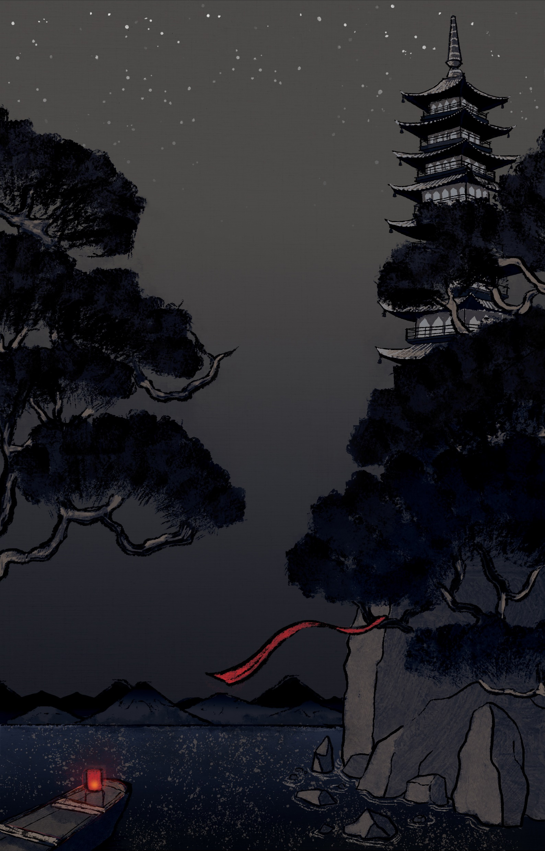


Slide 3
Project Goals
1: Concentrate on one simple mechanic but make it pop!
2: Polish it until it shines.

Slide 4
Scope
Must Have | Should Have | Nice to Have
Swiping Combat Mechanic ✔ | Particle Effects ✔ | Bosses CUT
Enemies x3 ✔ | Adaptive UI ✔ | Enemies x6 ✔
Player Character ✔ | Overworld ✔ | Level x3 ✔
Animations ✔ | Score ✔ | Achievements CUT
Level x1 ✔ | Stylized 3D Environments ✔ | Unlockables (Skins) CUT
SFX ✔ | Traditional Instrumentation ✔
 | Unique Monster Sounds ✔

Slide 5
DEVLOG

Slide 6
Ole Ortmann
Uses Pepsi as mouthwash

Slide 7
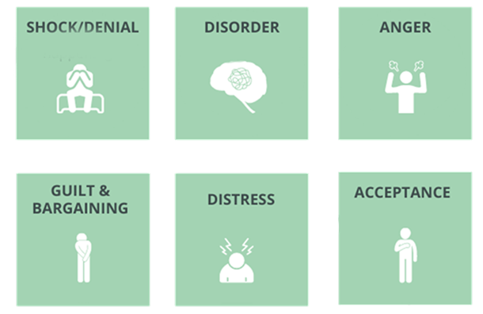
6 stages of grief mobile game development

Slide 8
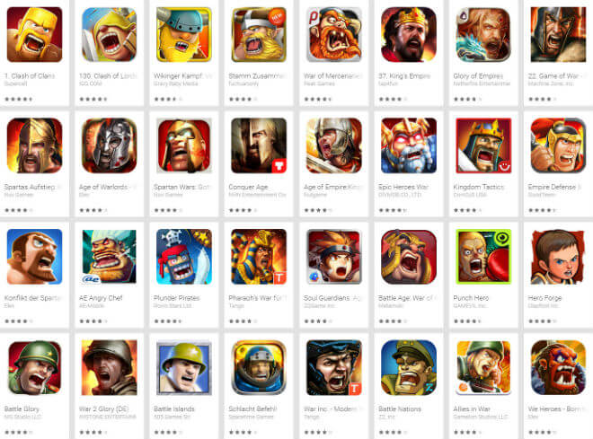
Shock/Denial

Slide 9
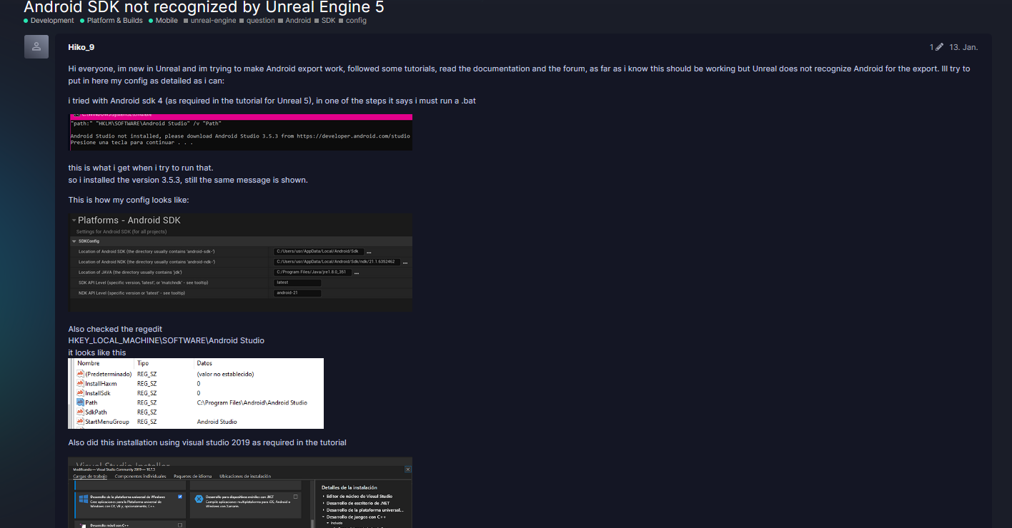
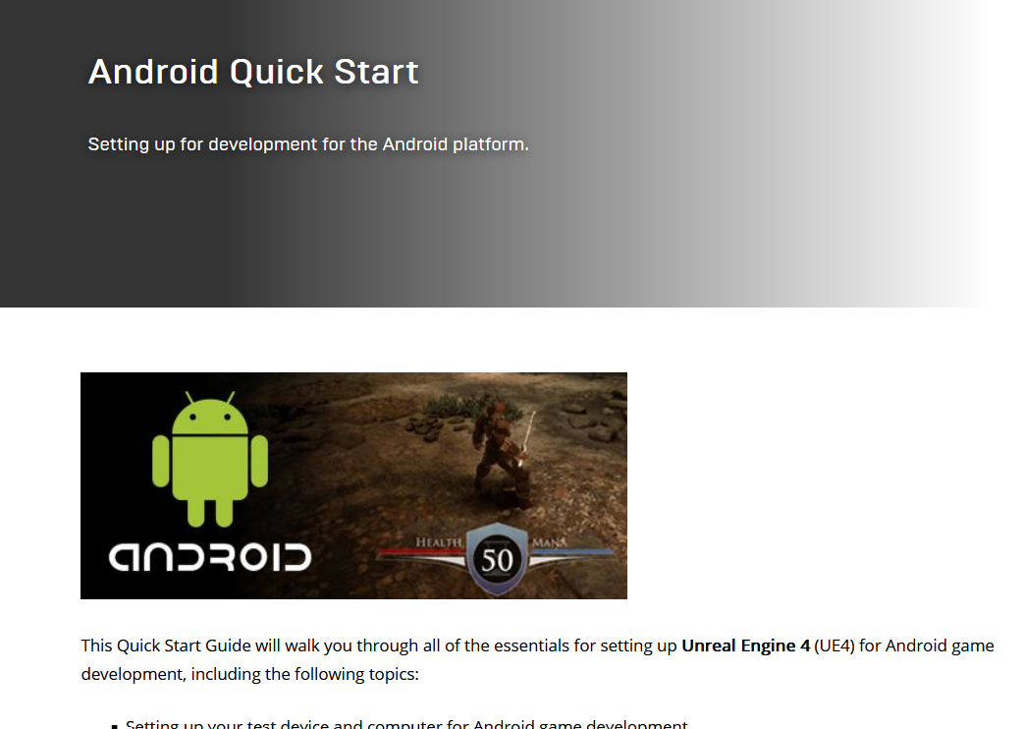
Disorder

Slide 10
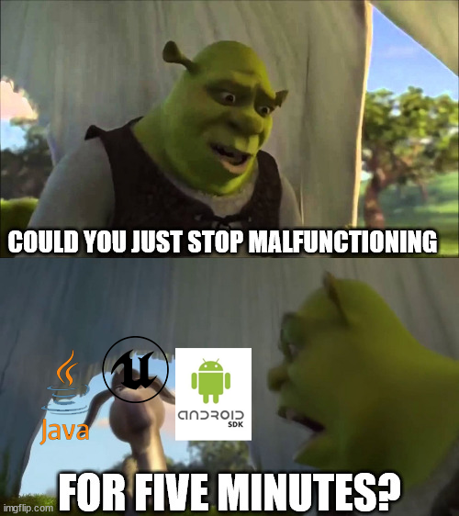
Guilt/Bargaining

Slide 11
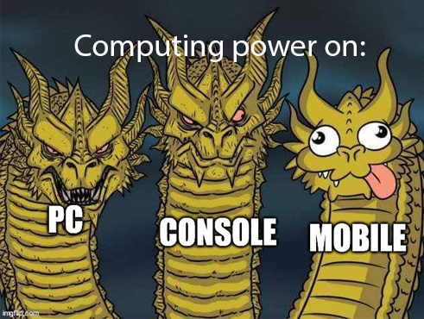
Distress

Slide 12
Acceptance
Good Game
(But never again)

Slide 13
Zhu Zhaoliang
Likes chicken teriyaki

Slide 14




In-game Music
INSTRUMENTATION
MELODIC
RHYTHM
TEXTURE

Slide 15
In-game SFX
Inspiration
Idea

Slide 16
Waiyaki Otieno
Totally not toxic

Slide 17
Michael Wick
Put proper pants on just for this occasion

Slide 18
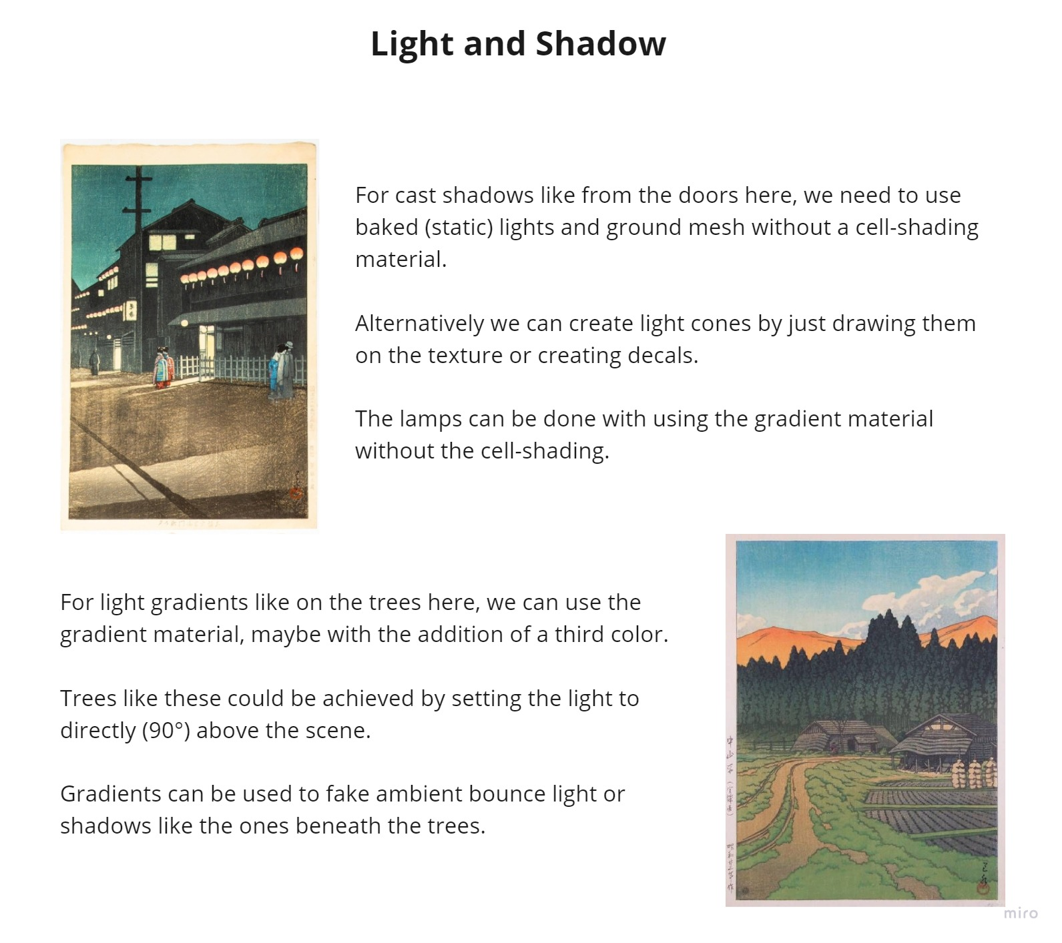
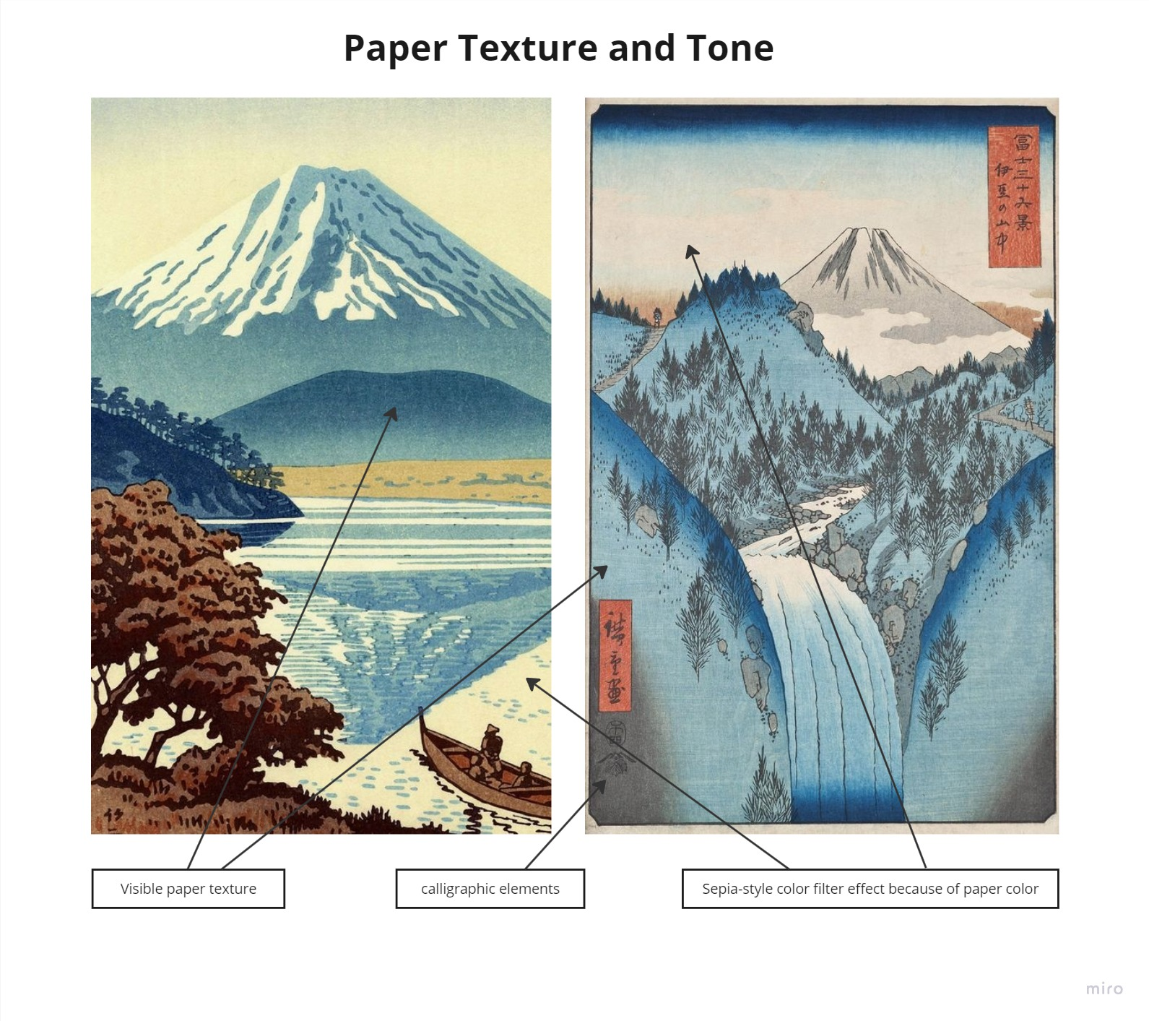
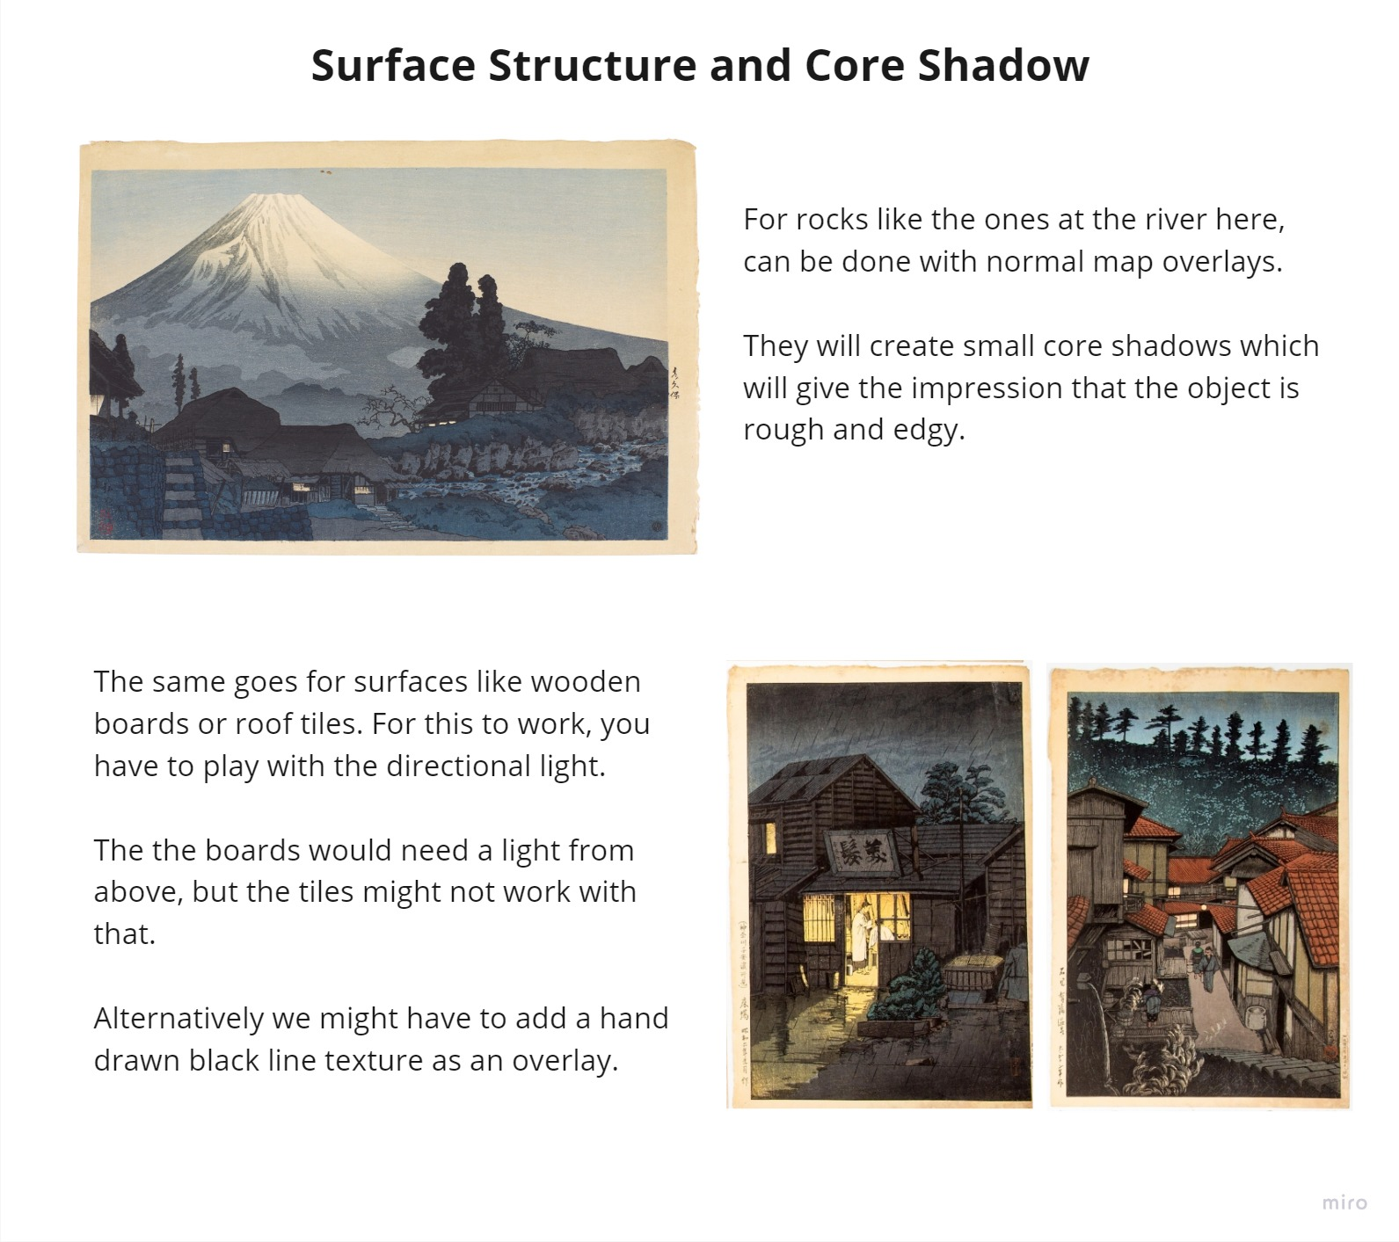
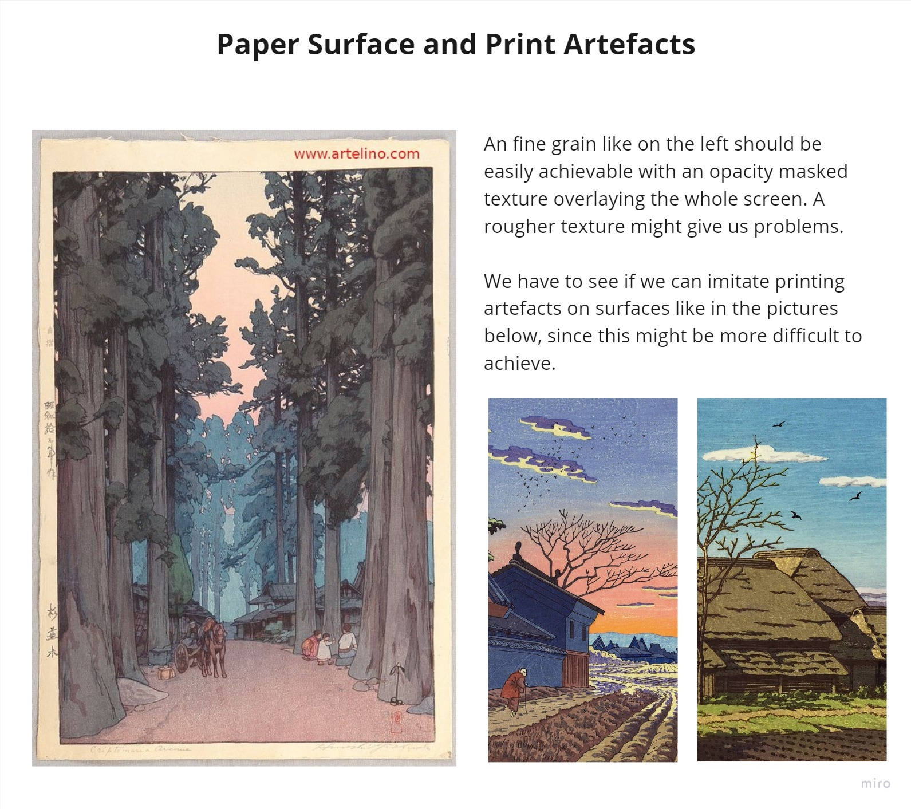
Environment Design

Slide 19

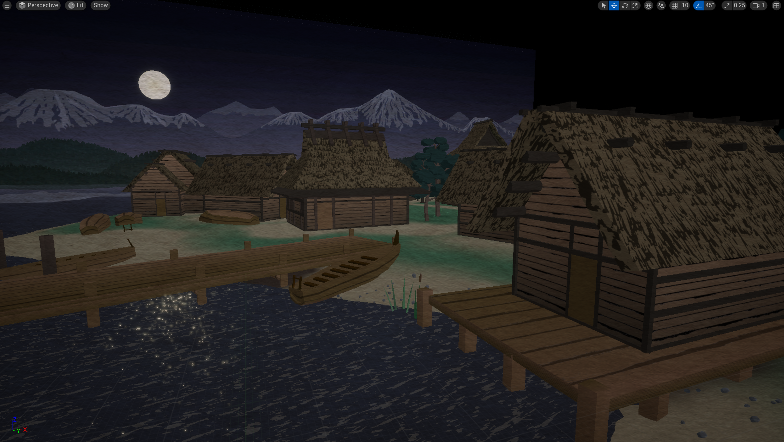
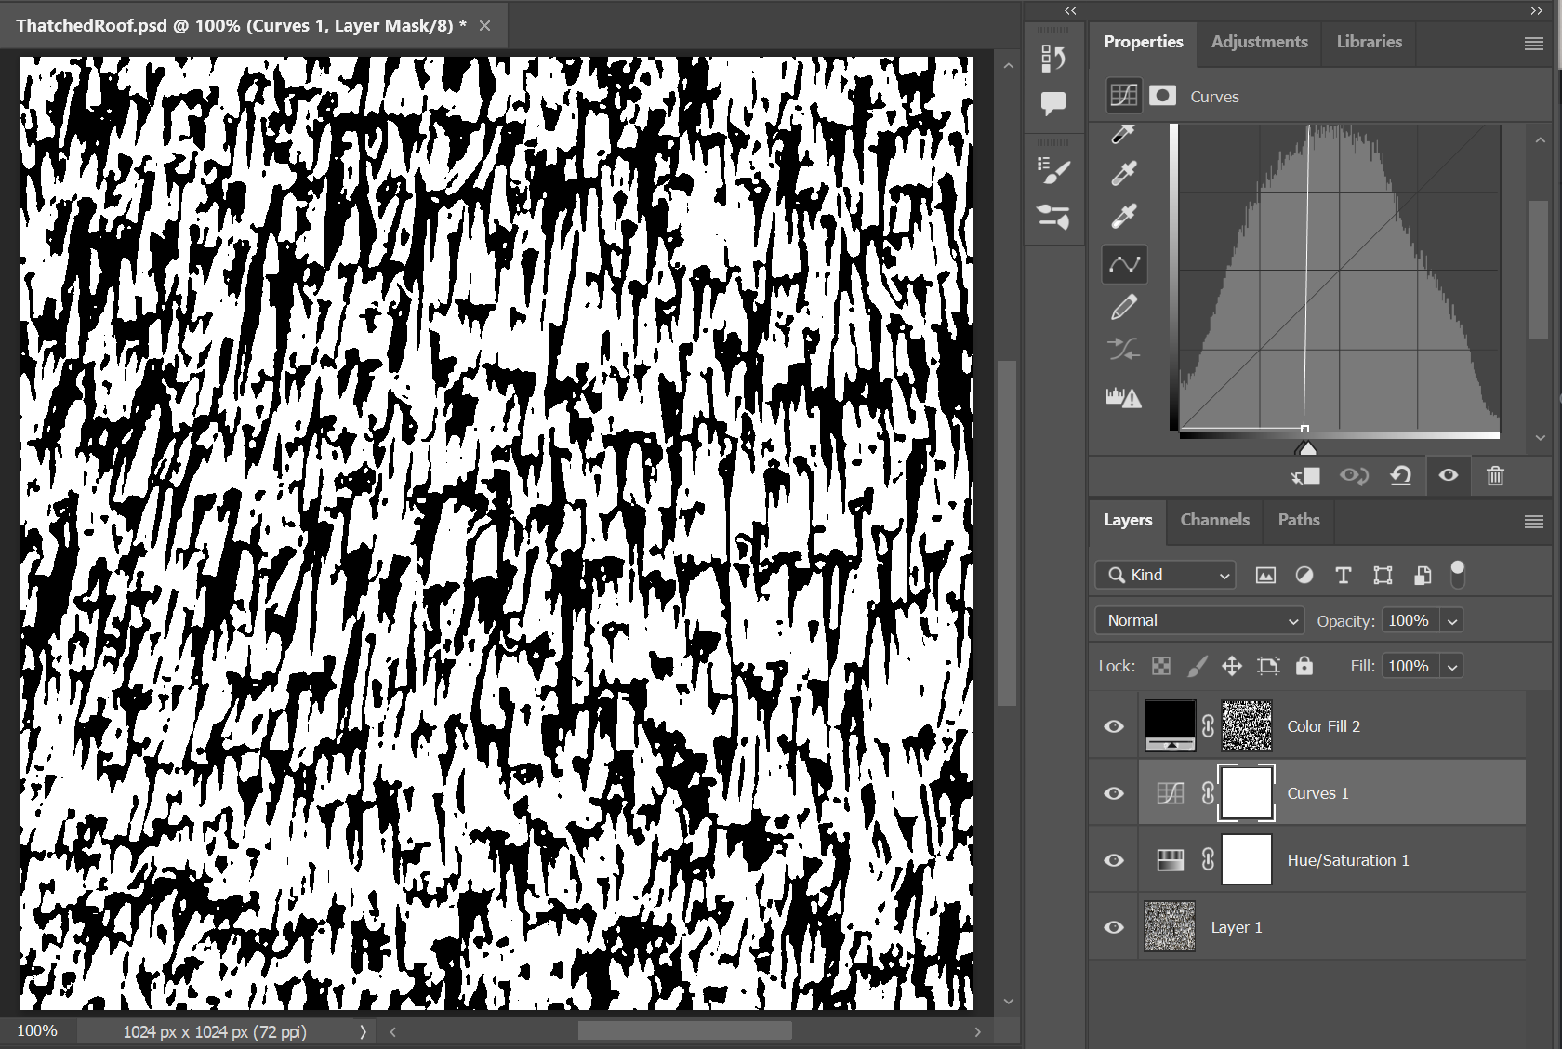
Environment Design

Slide 20
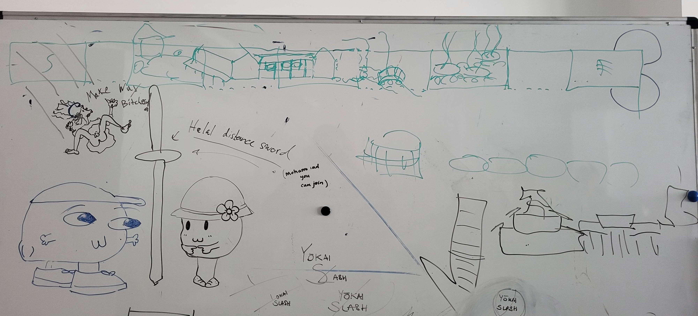
Environment Design

Slide 21







Environment Design

Slide 22
Katharina Bornemann
“You can choose my subtitle”

Slide 23
Mohamad Sharkawi
(Not a terrorist)

Slide 24
Victor Hübner
Just one more frame…

Slide 25

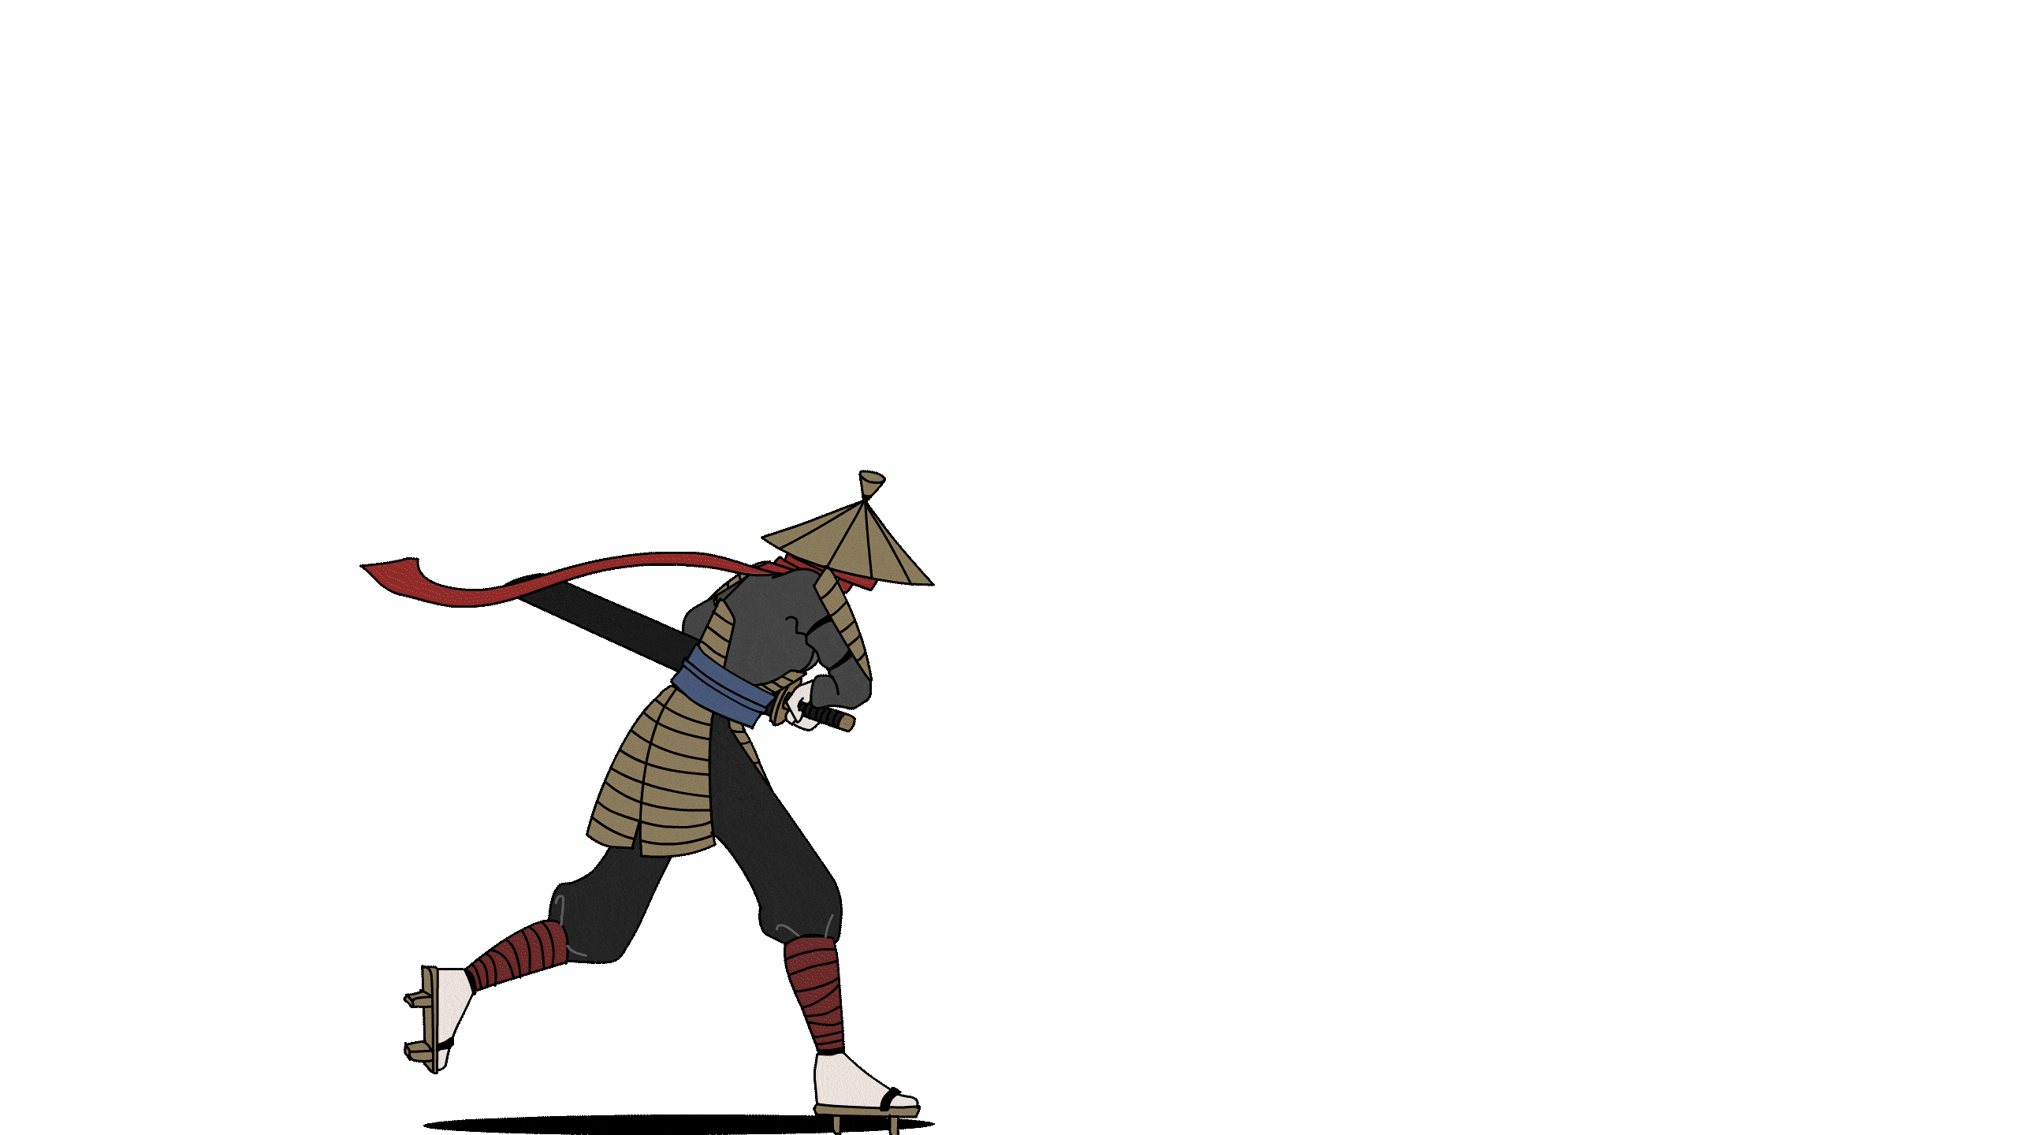




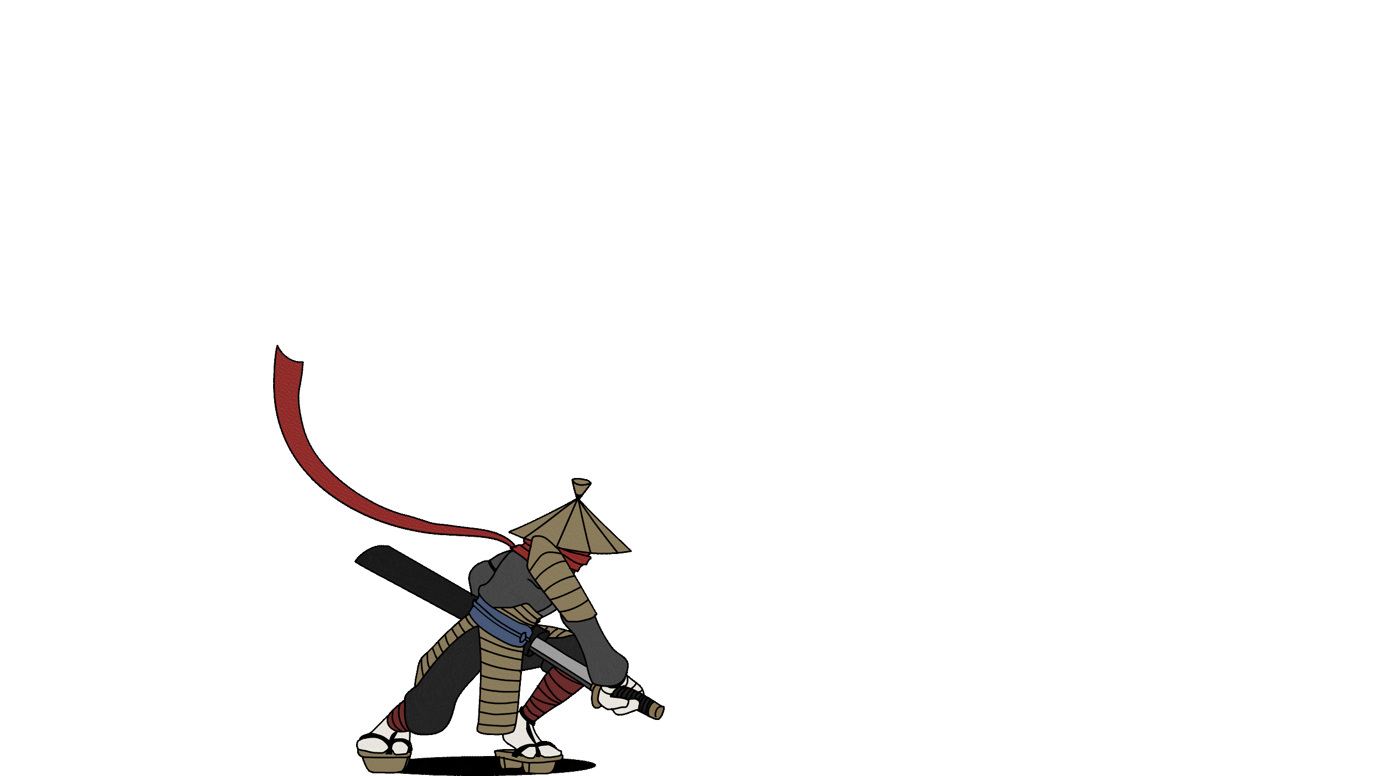





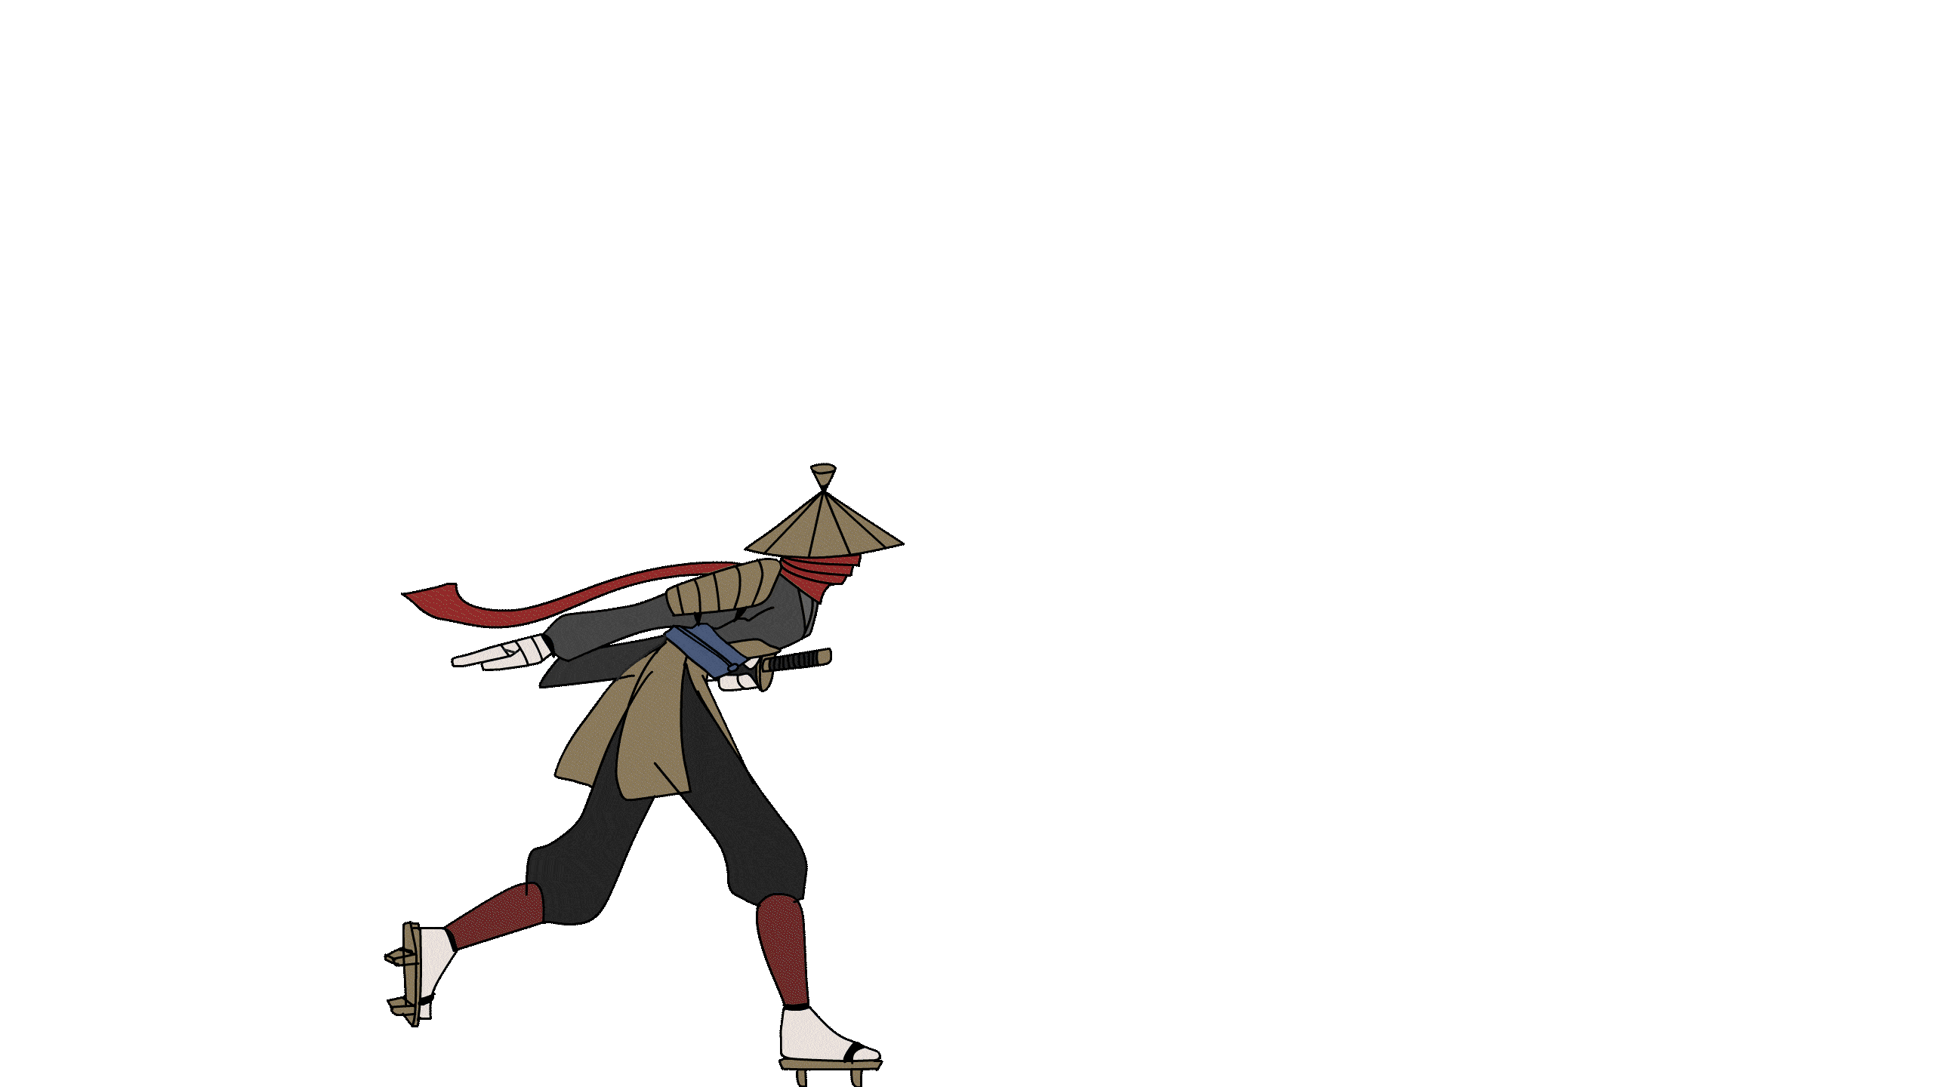
So many animations…

Slide 26
Angeli Fernando
This is the seventh iteration of this subtitle because Victor said the previous ones all had a style clash problem

Slide 27
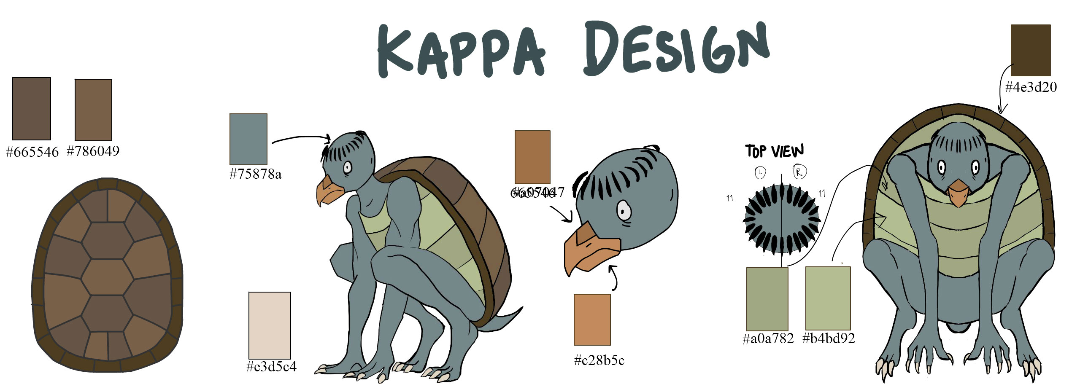
The Kappa

Slide 28
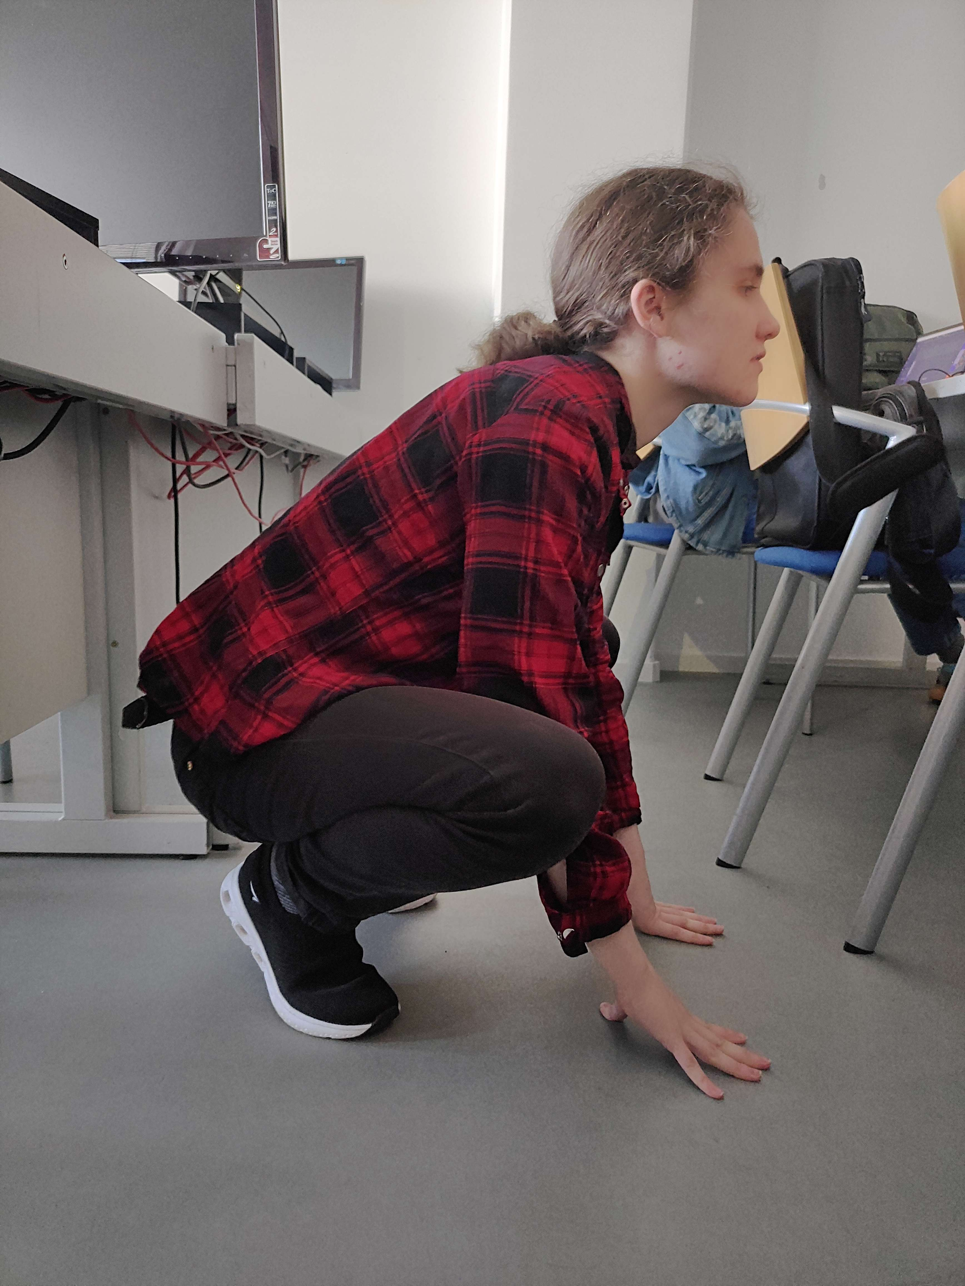
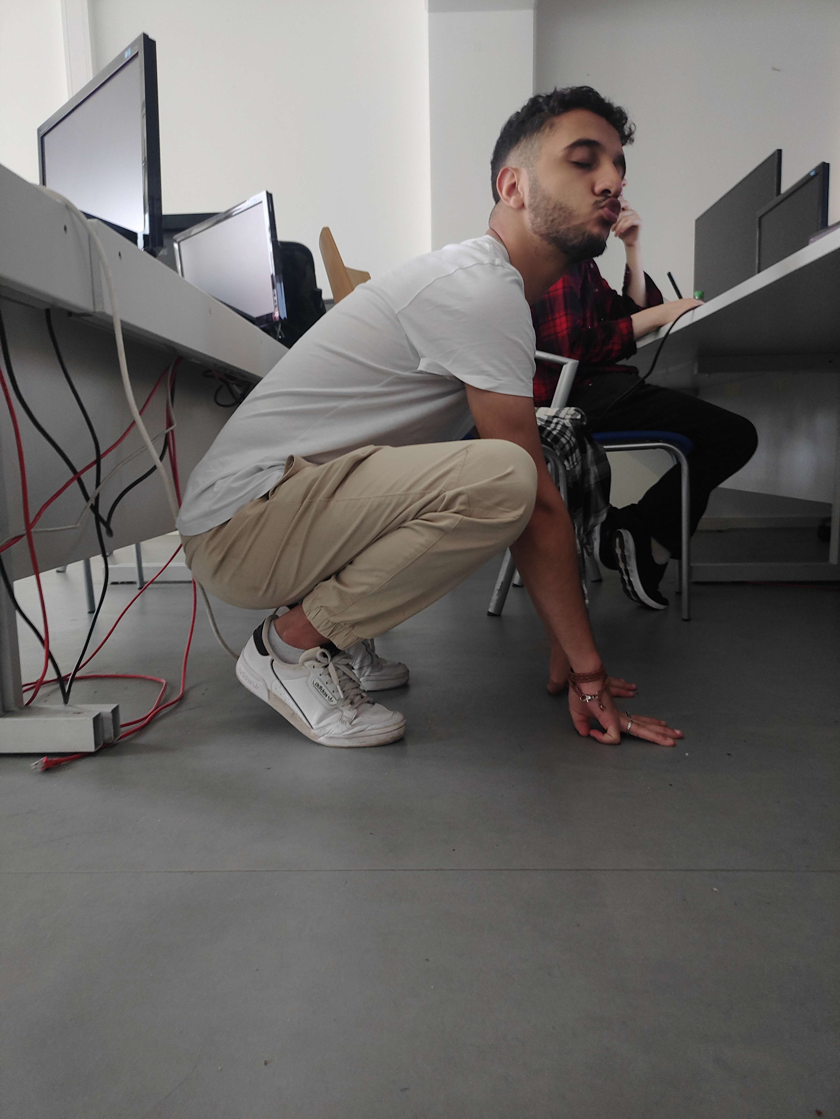
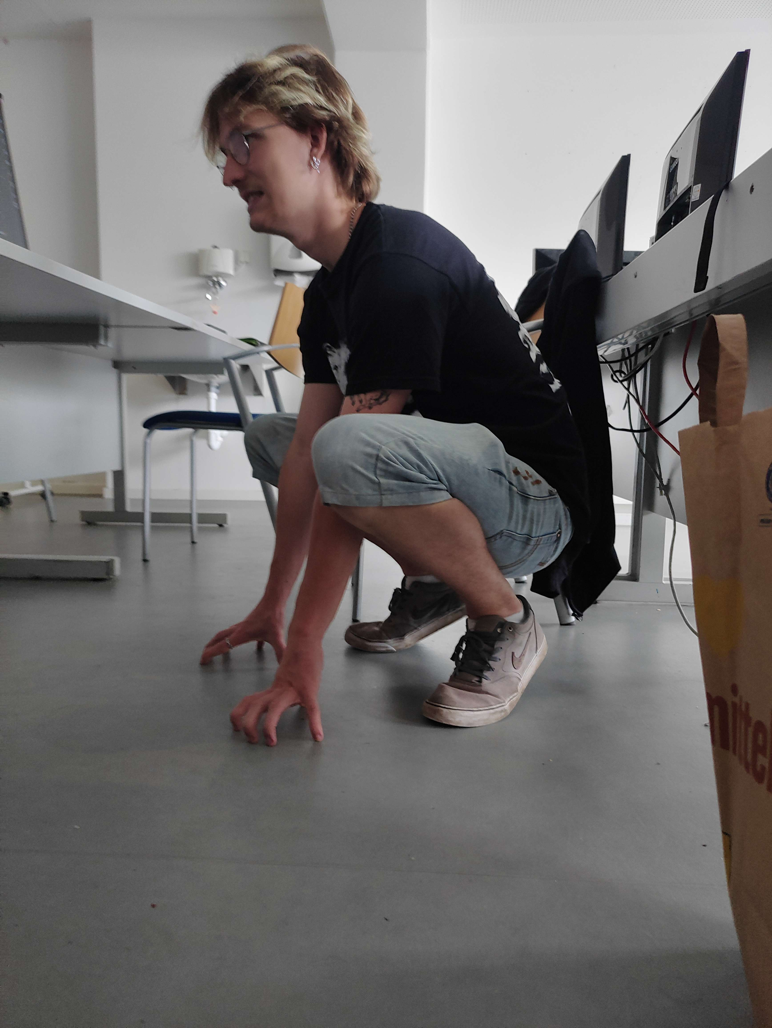
The Kappa

Slide 29
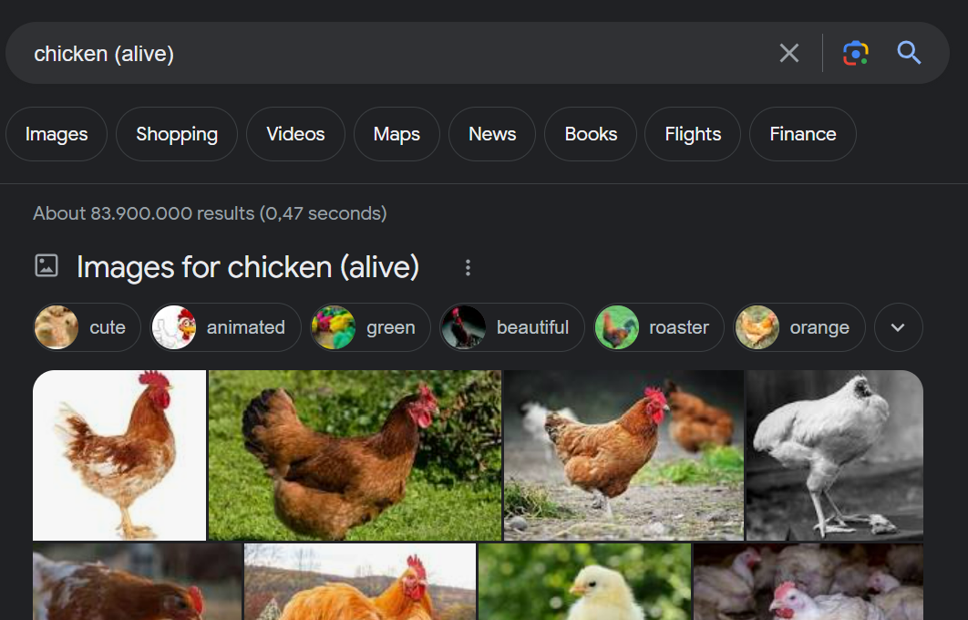
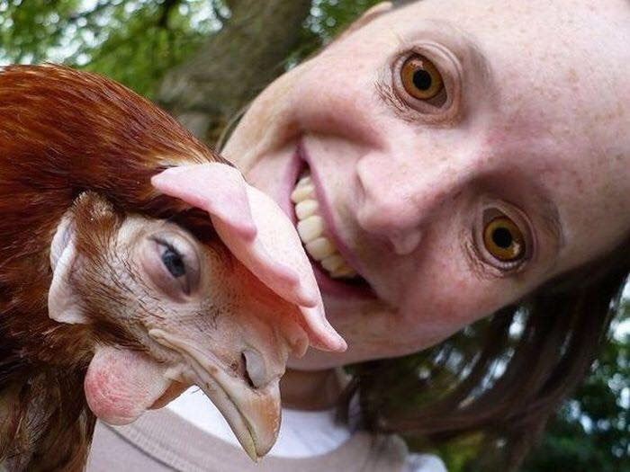
The Kappa

Slide 30
Hendrik Wagner
Has earned his Feierabendbier

Slide 31
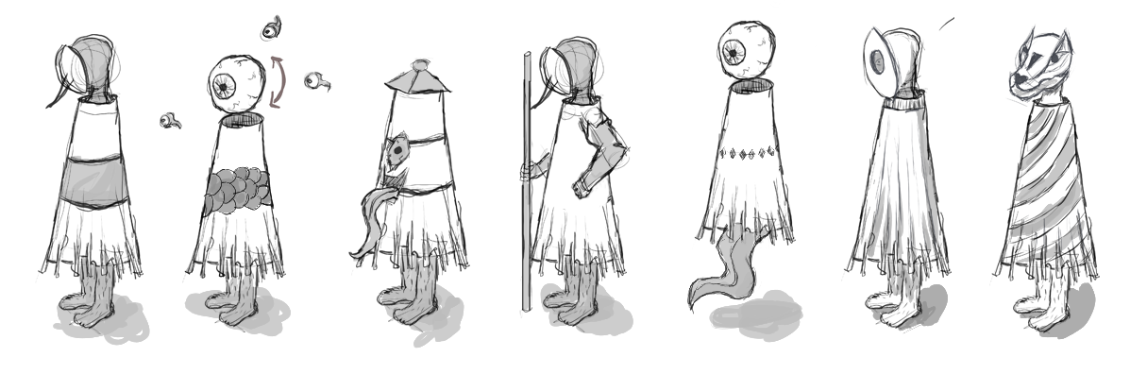
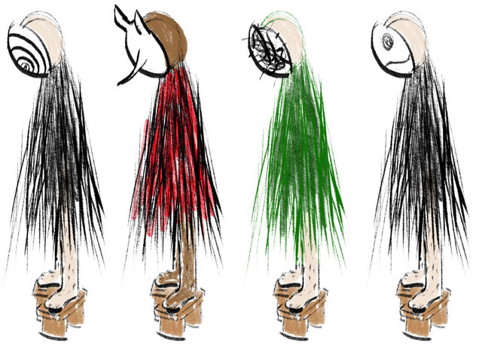
The Kasa Obake

Slide 32

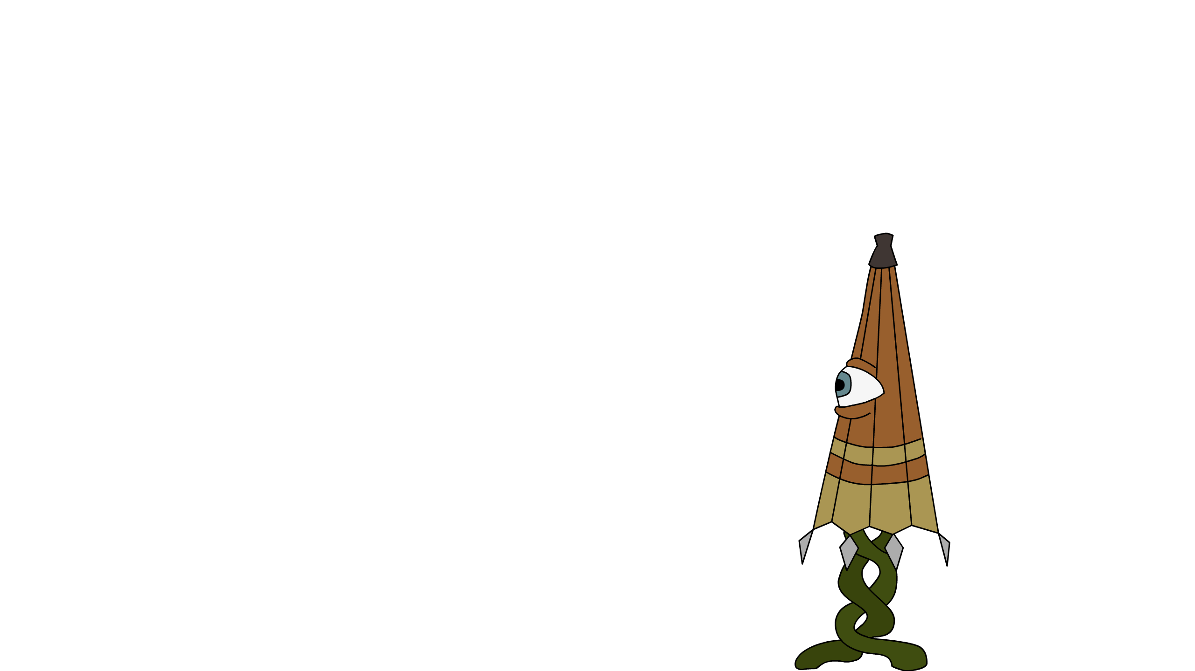
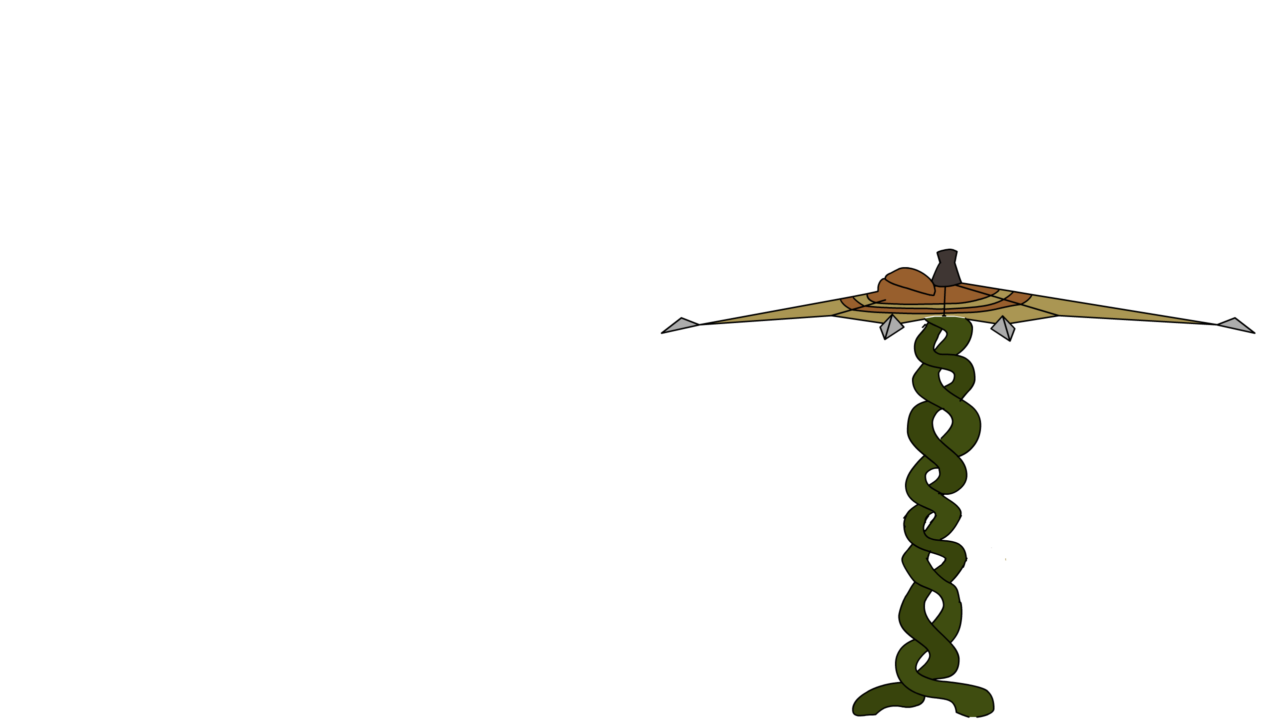
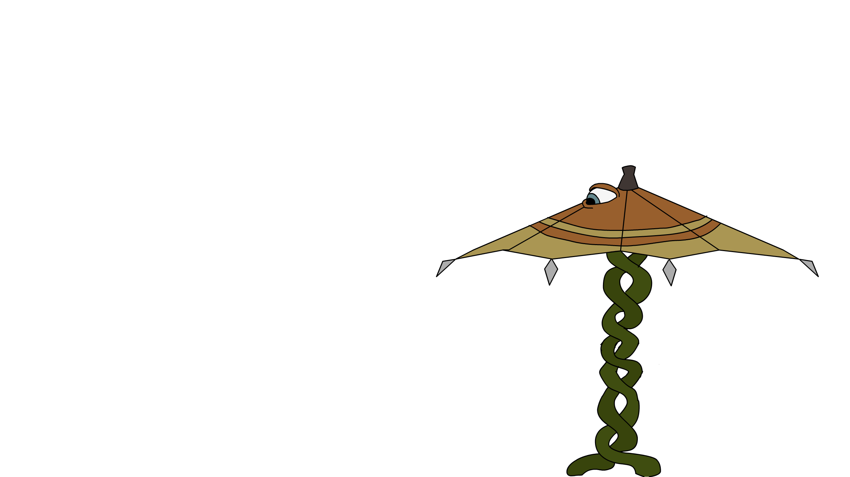
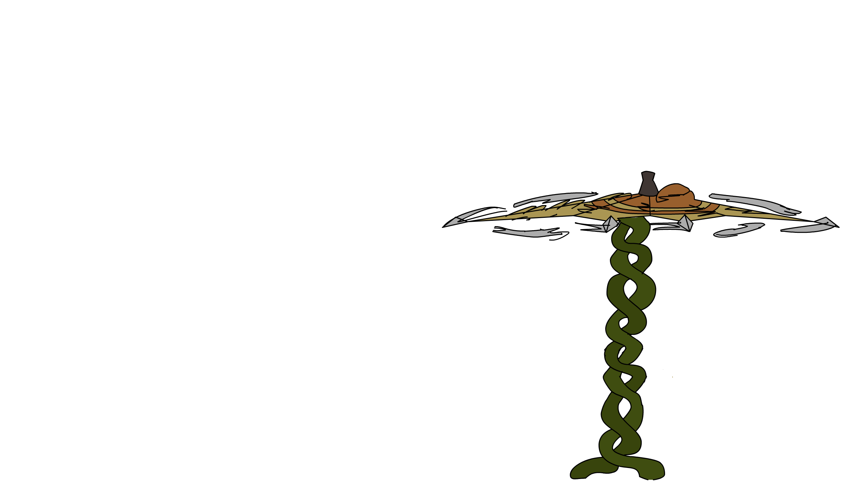
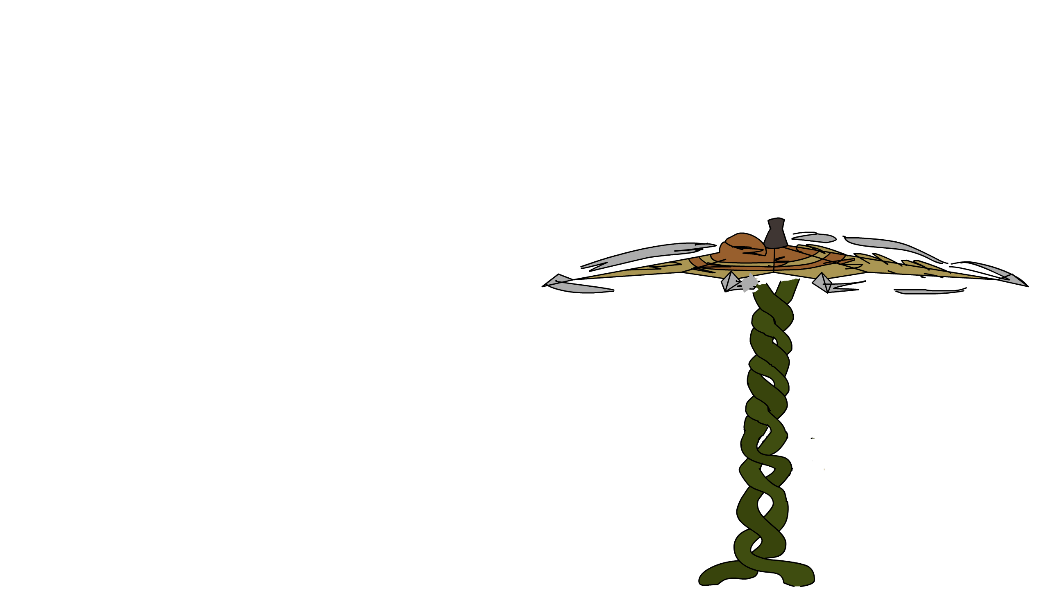
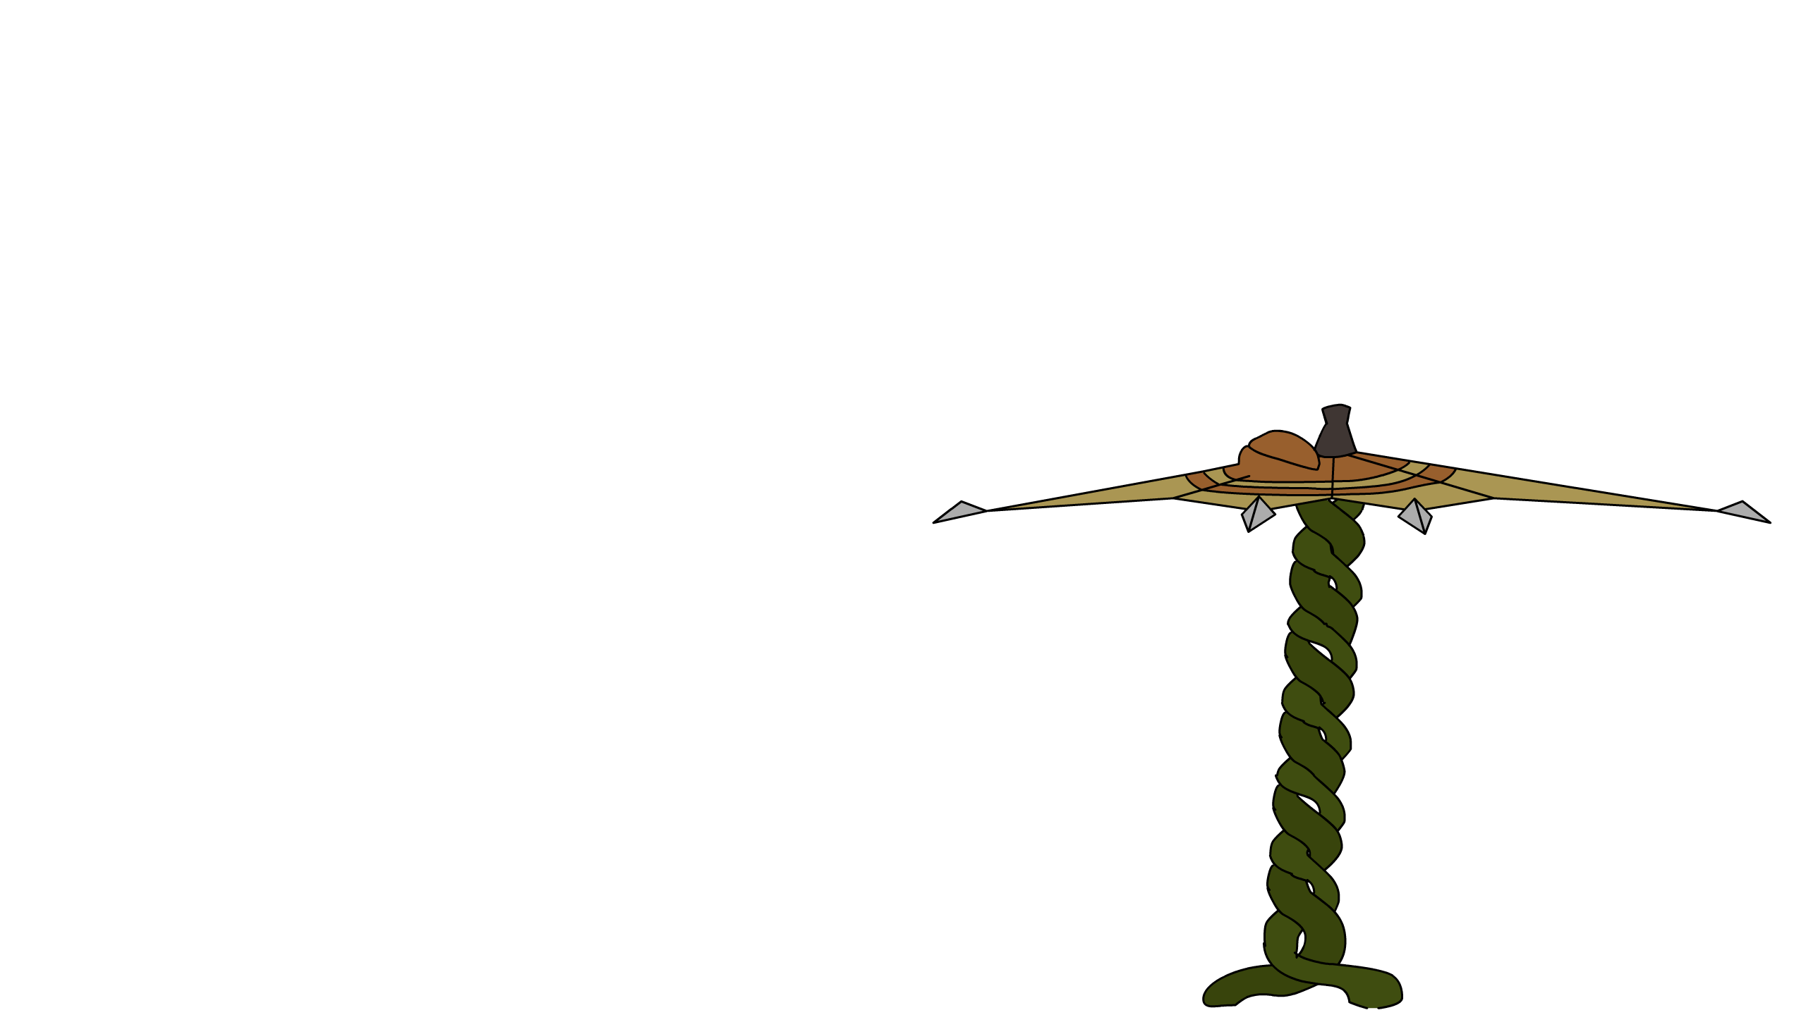
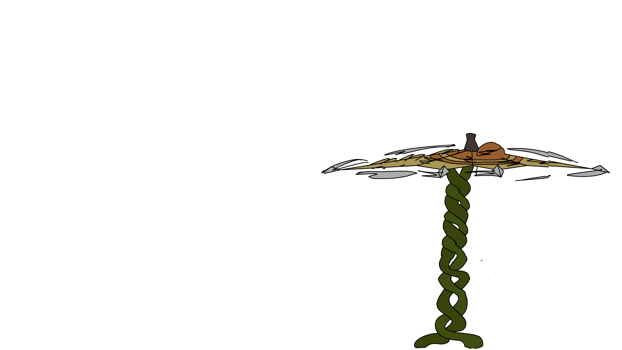
The Kasa Obake

